Slide 1
Creating RESTful Web APIs
RESTful Web APIs | HTTP Request Verbs| Express Routers | Updating A Database | Search By Genre and ID | Updating and Deleting Songs
Notes:
Welcome to our lecture on how to create RESTful Web API. In this lecture we will go through introduction to RESTful web API, HTTP requests, express routers, how to update a database, search by genre and id and how to update and delete songs. Let’s start the video lecture.

Slide 2

RESTful Web APIs
Web APIs enable data exchange between browsers, servers, and clients.
Clients send web API requests (e.g., from mobile apps or smartwatches).
RESTful APIs follow REST principles and support CRUD operations.
Resources are data entities accessible via URLs (e.g., /customer).
Notes:
Now, let’s dive into RESTful web APIs. These APIs facilitate data exchange between different systems, like browsers, servers, and mobile devices. Clients, such as mobile apps, send requests to web APIs. RESTful APIs follow specific principles and support standard operations like creating, reading, updating, and deleting data. Resources refer to data entities that are accessible through URLs, such as customer information.

Slide 3
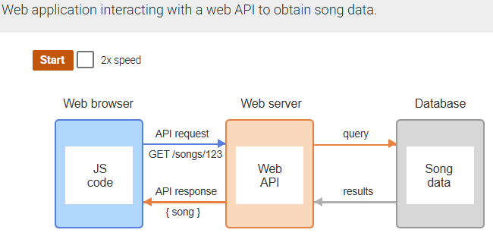
Example
Notes:
Here, we see an example of how a web application interacts with a web API to retrieve song data. The web browser sends a request to the web server, which then communicates with the database to fetch the relevant song data. The web API processes the request and returns the song information back to the browser, enabling seamless data exchange.

Slide 4
HTTP Request Verbs
RESTful web APIs typically use four of the HTTP request verbs to implement CRUD operations:
POST - Create a new resource
GET - Retrieve a resource
PUT - Update a resource
DELETE - Delete a resource
Notes:
When working with RESTful web APIs, four main HTTP request verbs are commonly used to perform CRUD operations. The POST method is used to create new resources, GET retrieves existing resources, PUT updates resources, and DELETE removes resources. These verbs allow us to manage data efficiently within an API.

Slide 5
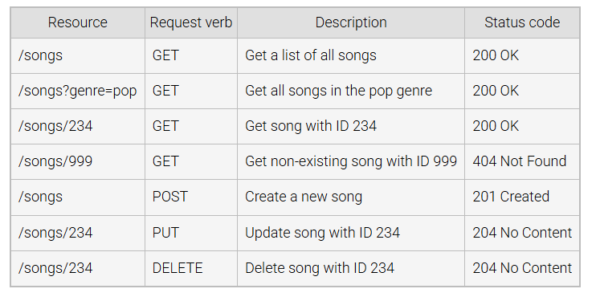
Example requests and responses for a Music API
Notes:
Here are some example requests and responses for a music API. The first request fetches a list of all songs, while others filter results by genre or specific song IDs. If a non-existing song is requested, an error status code is returned. Requests for creating, updating, or deleting songs also return appropriate status codes indicating the result of each operation.

Slide 6
Express Router
express.Router creates modular route callbacks for APIs.
Endpoints are URLs that access resources (e.g., /api/movies).
Express server listens on a port (e.g., 3000).
GET request to /api/songs returns a song in JSON format.
Notes:
The Express Router helps us organize API routes by creating modular route callbacks. These routes, known as endpoints, provide access to specific resources like movies or songs. The server listens on a port, such as port 3000, and when a GET request is made to a particular endpoint, it returns the requested data in a format like JSON.

Slide 7
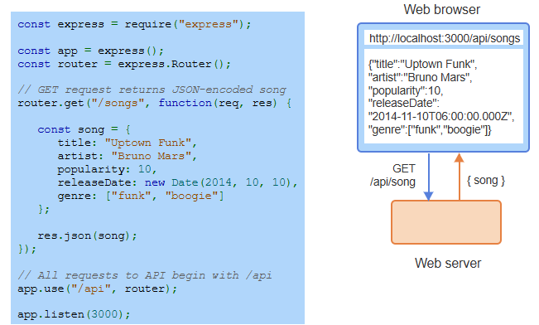
Example
Notes:
In this example, a web server is set up to respond to requests made to the /songs endpoint. When a GET request is sent to this endpoint, the server responds with a song's data in JSON format. This includes details like the title, artist, popularity, release date, and genre. The router organizes these API routes under the "/api" prefix, allowing for structured data retrieval.

Slide 8
Using Database
find() retrieves all songs from the database.
save() stores a new song in the database.
Uses Mongoose to connect Express with MongoDB.
Notes:
To interact with the database, we use methods like find and save. The find method retrieves all songs stored in the database, while save allows us to add a new song. To connect the Express application with the database, we use a library that facilitates communication with MongoDB, ensuring smooth data operations.

Slide 9
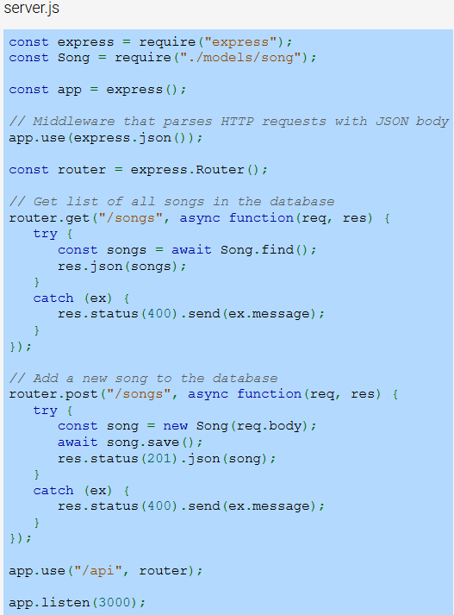
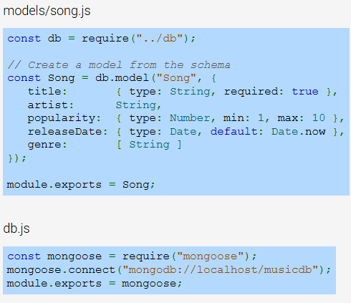
Music API using Mongoose to access/save data in MongoDB.
Notes:
In this example, we are building a music API using Mongoose to interact with a MongoDB database. First, we define a song model based on a schema in the models file. The server code listens for requests and performs operations like retrieving a list of songs or adding a new song to the database. The API enables seamless communication between the web application and the database.

Slide 10
Search by ID and Genre
Search by genre using the "genre" query parameter.
Filter songs based on the specified genre.
Enhances the Music API for more specific searches.
Notes:
In this enhanced Music API, we can now search for songs by genre using a query parameter. By specifying a genre, we filter the songs to only display those that match the given genre. This adds more specificity to the searches, allowing users to quickly find songs based on their preferred genres, making the API more efficient and user-friendly.

Slide 11
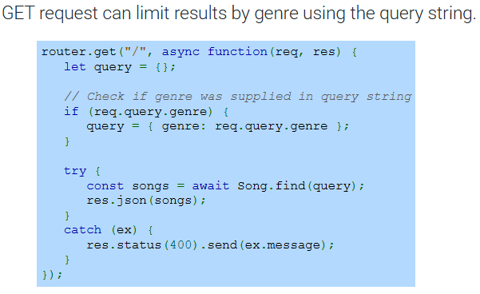
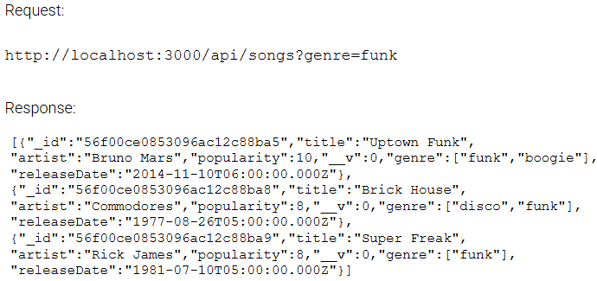
Example
Notes:
In this example, a GET request is used to filter results based on the genre provided in the query string. If a genre is specified, the API will return only songs that match the genre. In this case, the request filters for songs in the "funk" genre, and the response contains a list of matching songs with their details such as title, artist, and release date.

Slide 12
Updating and Deleting Songs
PUT request updates an existing song using updateOne().
Returns 204 for success, 400 for errors, 404 if ID not found.
Updates data from the request body in the Music API.
Notes:
In this section, we focus on updating and deleting songs using the PUT request. The PUT request allows us to update an existing song by passing in the new data through the request body. Upon success, it returns a status code of 204, while errors return a 400 status, and a 404 status is given if the song ID is not found.

Slide 13
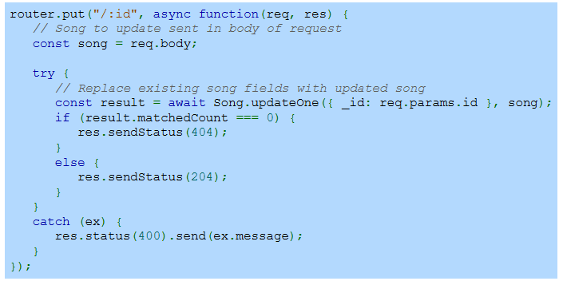
Update song's title and popularity with PUT verb in Music API
Notes:
In this example, we use the PUT request to update a song's title and popularity. The song details are sent in the request body, and the server updates the existing song in the database based on the song's ID. If no song is found with the specified ID, a 404 status is returned. Otherwise, a 204 status indicates a successful update.

Slide 14
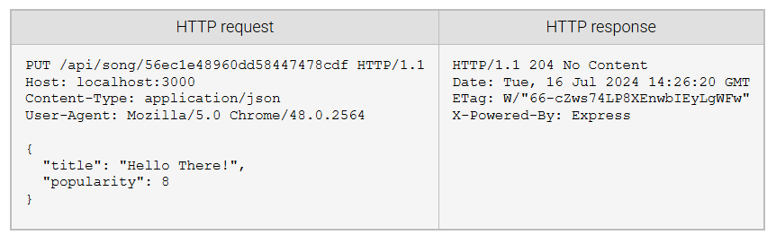
Update song's title and popularity with PUT verb in Music API (Continue)
Notes:
Here, we see an example of a PUT request used to update a song's title and popularity. The request body contains the new title and popularity rating. The server responds with a status code of 204, indicating the update was successful. This confirms the song was updated without returning any additional content in the response.

